Slide 1
AILP – Allianz Initial Learning Program
Amrutha Mohan (T10313)
IT DATA Team (SAS)
13th September, 2018

Slide 2
CONTENTS
1. ABOUT ALLIANZ | 6. IT DATA TEAM
2. KEY LEARNINGS | 7. SAS TECHNOLOGY
3. PROJECT – WEB DEVELOPMENT | 8. CLAIMS
4. APPLICATIONS & TOOLS | 9. PARTICIPATIONS
5. PROJECT SCREENSHOTS

Slide 3
01
Allianz

Slide 4
Allianz at a glance
Worlds 3rd largest financial services company by revenue
140,553 Employees
85 million customers
70 Countries
Gender equality and equal pay

Slide 5
02
Key Learnings

Slide 6
Learnings
Technologies
Core Java
JSP, JSTL
Servlet
HTML, CSS
Java Script, Ajax
Database Basics
Oracle DB
SQL
PL/SQL
Basics of Insurance
Sessions
Corporate Induction
Team Induction
Agile
ACDM

Slide 7
03
Project – Web Development

Slide 8
Flow Chart
Login
Manage Employees
Add Line Manager
Add/ Search/ Edit/ Delete Employee
Upload Trainings
Report Generation
Change Password
Logout
Login
Scoreboard
Profile
Change Password
Logout
Activate Account

Slide 9
04
Applications & Tools

Slide 10


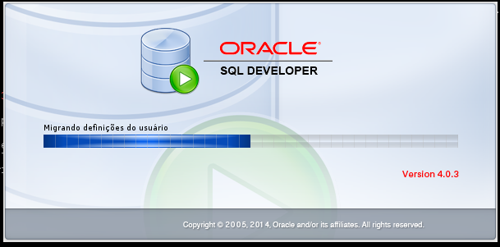
Applications
Server : Apache Tomcat 9
IDE : Eclipse Neon
DB IDE : Oracle SQL Developer 4.0.3

Slide 11








Tools

Slide 12
05
Project Screenshots

Slide 13

Index Pages
H

Slide 14

Admin : Home Page

Slide 15
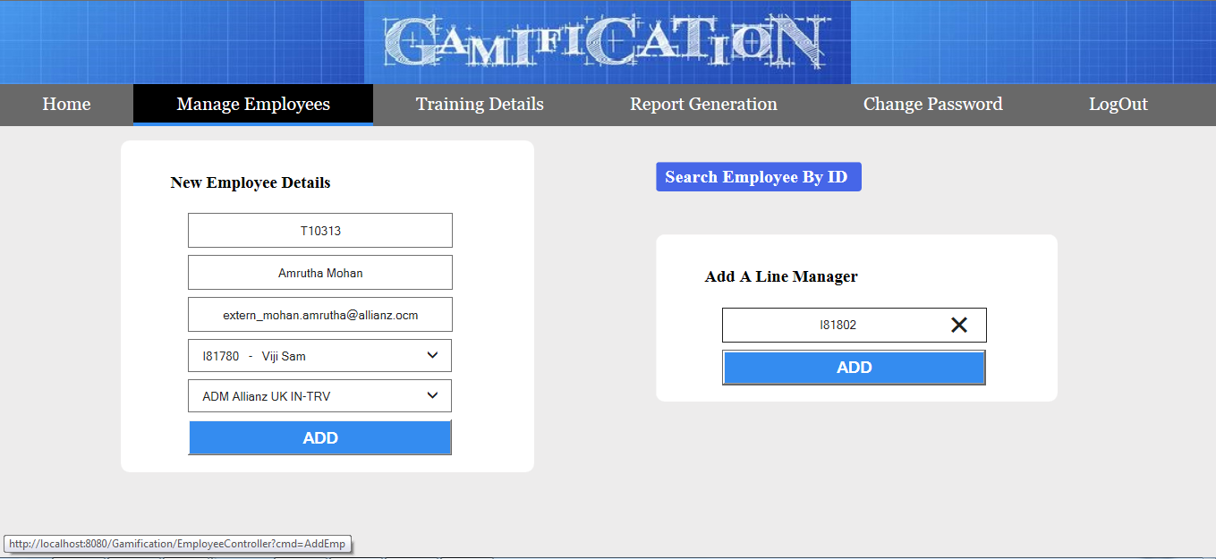
Add an Employee & Line Manager

Slide 16
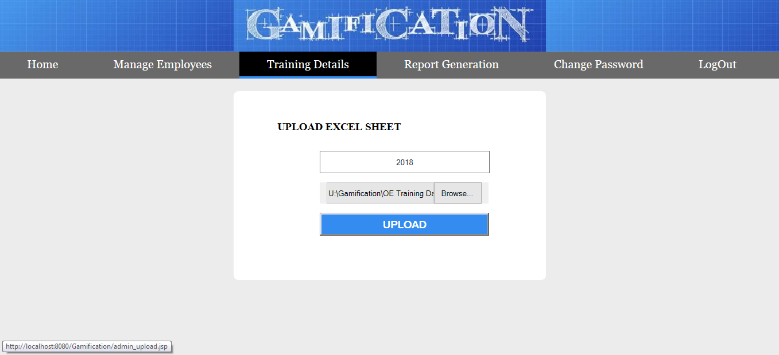
Upload Excel Sheet

Slide 17
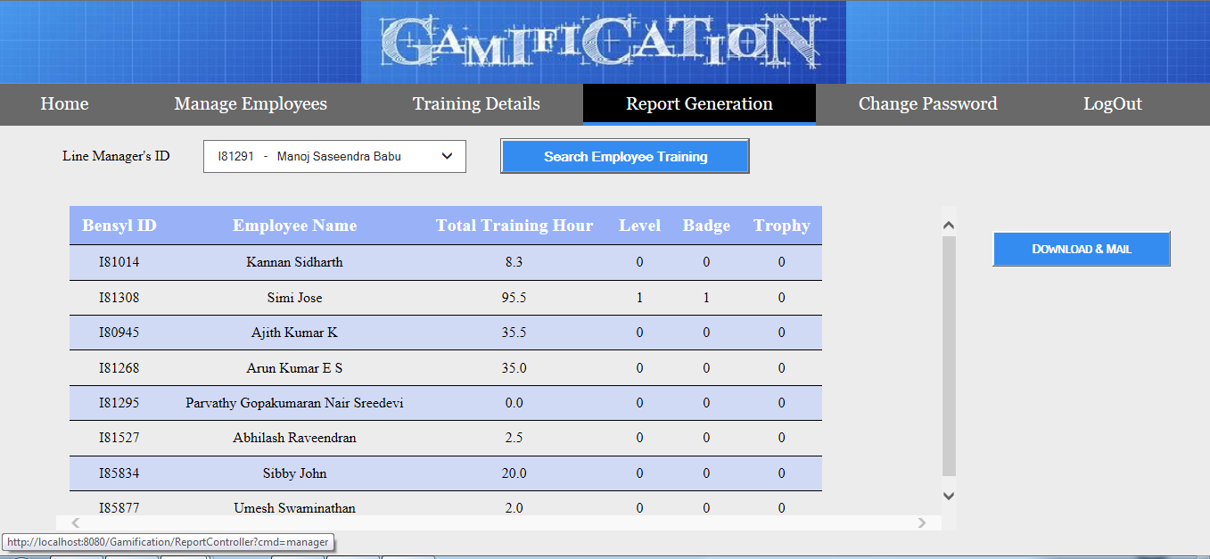
Report Generation

Slide 18

Employee Home Page

Slide 19
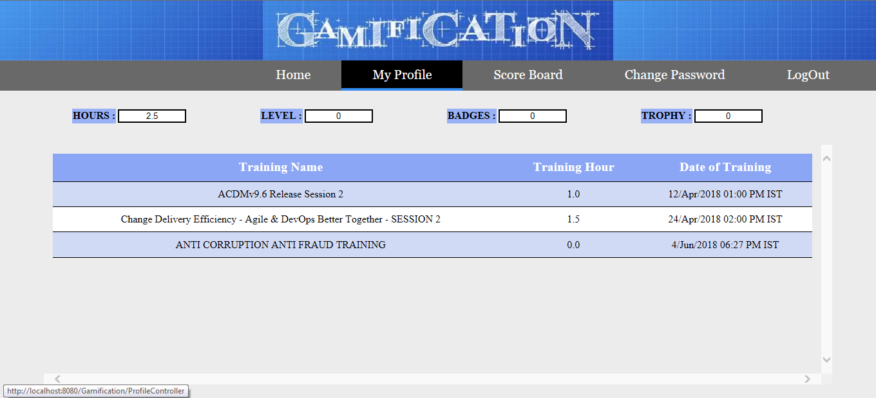
Employee Profile

Slide 20
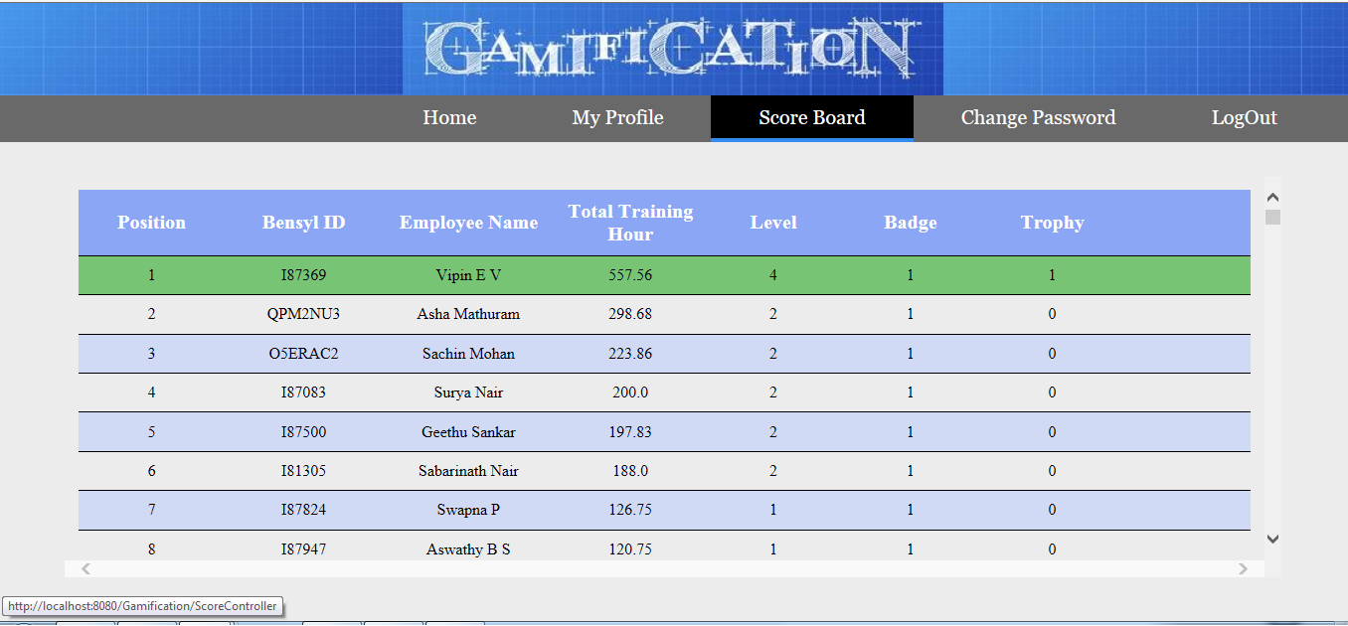
Employee Scoreboard

Slide 21
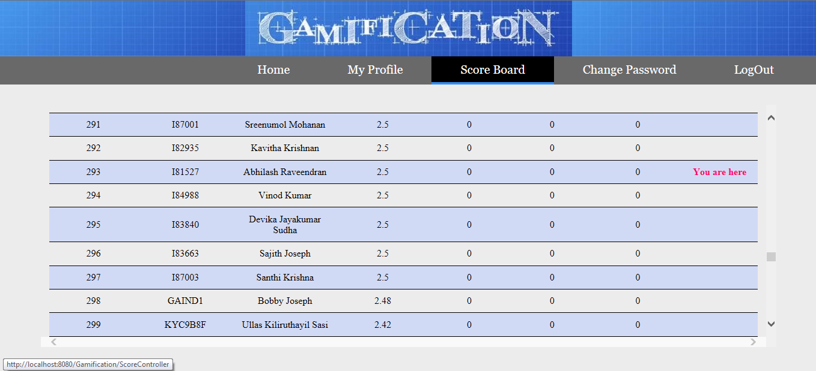
Position Relative to Others

Slide 22
06
IT Data Team

Slide 23
Team
Corporate MIS Team
EBI IT Team
IT Data Team

Slide 24
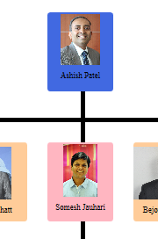

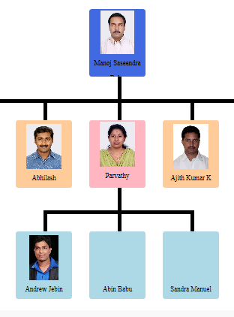
Organizational Chart

Slide 25
About Team
Focuses in the management of operational systems data which helps in efficient and effective strategic decision making.
MIS(Management Information System) : Logical and well structured method of collecting, processing and disseminating information to the decision makers.
Strategic planning, management control, operational control and transaction processing.
Notes:
3. Thus MIS helps in strategic planning, management control, operational control and transaction processing.
CUSTOMER GROUP?
Actuarial and Planning - Provides the GLM data for
statistical analysis
Accounts Team - Supports Accounts team in the
generation of reconciliation reports between different
systems and sends inputs to SAP
Commercial Lines Business Users - Provides reports
on different date basis (E.g. Financial date basis, Effective
date basis, Underwriting date basis and Triangle reports)
Retail Business – A number of reports for Retail Direct,
Retail Broker and Retail Corporate Partners (Schemes)
[E.g. Triangles, Portfolio based reports, Profitability reports]
Claims Business - Generates Dashboards, Web reports
and Claims Specialist reports
Senior Managers - Financial Results Pack and Daily claims
alert reports
Technology
Primary Technology: SAS Base: Macros/Base
SAS BI: SAS OLAP Cube Studio/ SAS Web Report Studio/ SAS Information
Delivery Portal/ SAS Data Integration Studio/SAS Enterprise
Guide/SAS Information Map Studio/SAS Management Console
Supportive Technologies: Mainframes, UNIX, Windows and Oracle

Slide 26
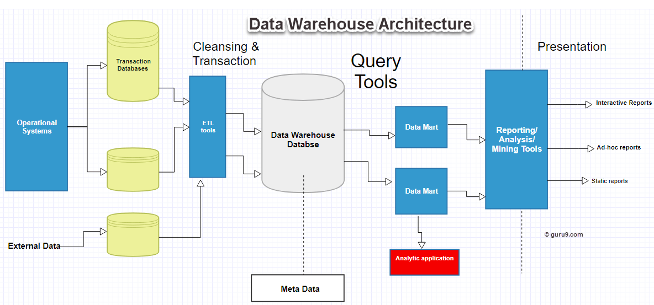
Data Warehouse

Slide 27
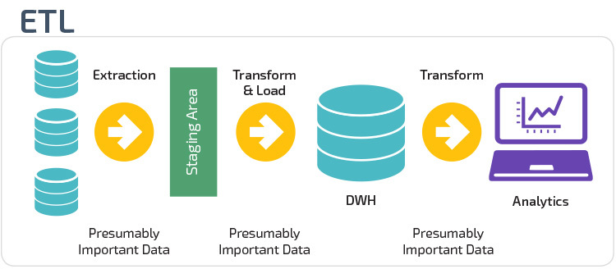

Slide 28
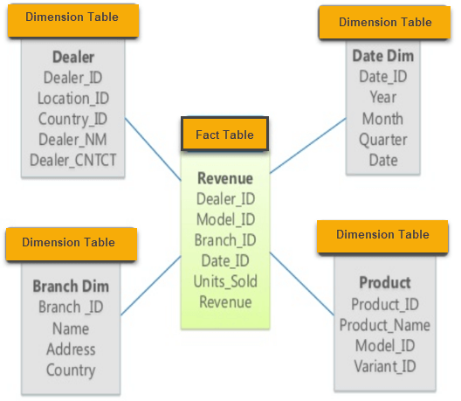
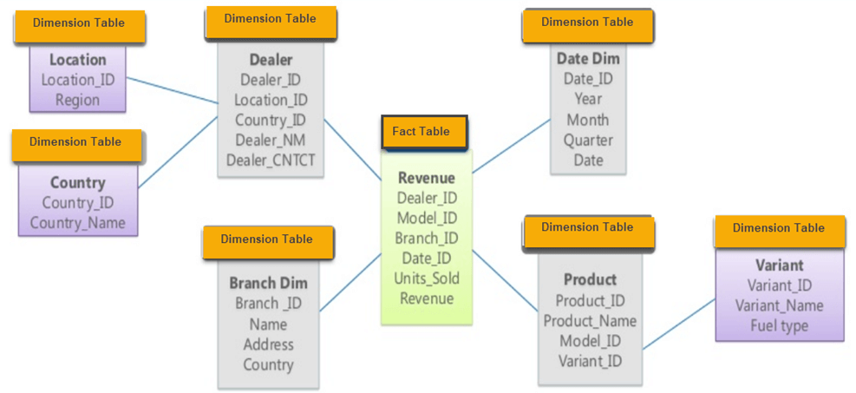
Multidimensional Schema
Star Schema
Snowflake Schema

Slide 29
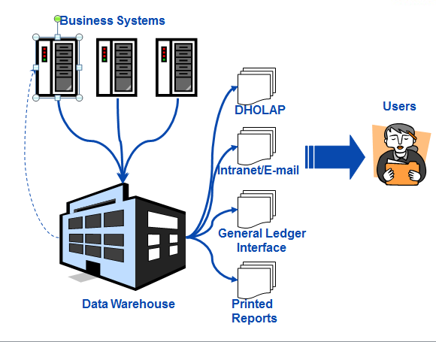
Allianz Data Warehouse

Slide 30
Data Flow
DHOLAP Reports
Platform
Low Level
Model
Web Reports
Extracts
Excels
Data Warehouse

Slide 31
07
SAS Technology

Slide 32

Company (SAS Institute) and Software.
SAS suit has more than 200 components.
Base SAS
SAS/ACCESS
SAS Data Quality Server
SAS/STAT etc.
SAS is a 4GL.
ETL Tool & BI.

Slide 33
SAS Programming
Only two datatypes : Character & Numeric
Formats and Informats. Format : How to write data. Informat : How to read data.
Eg : DATEw. Like date7. ( Aug 16, 1995 -> 16AUG95)
SAS Dataset : Variables and Observations.
DATA Step & PROC Step of a SAS program.

Slide 34
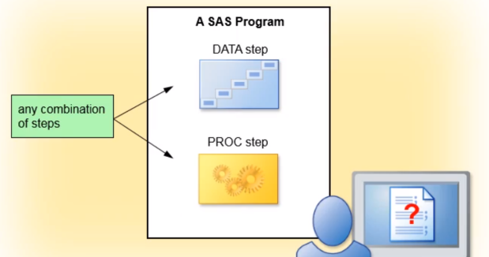
SAS Program Structure
Read and Modify data.
Create SAS Data Set.
Perform specific analysis or function.
Produce results or output.

Slide 35
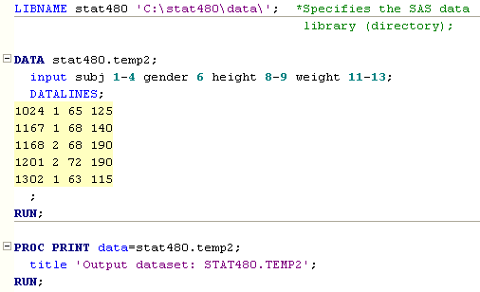
Sample SAS Program

Slide 36
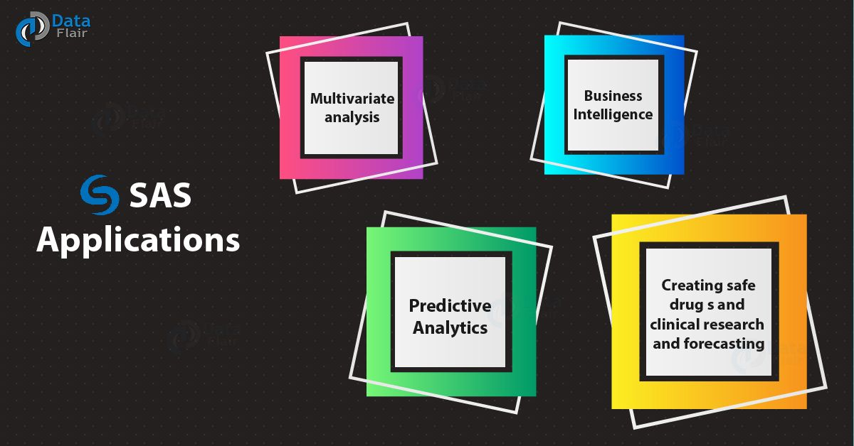
Applications of SAS

Slide 37
08
Claims

Slide 38
What is a Claim?
Claim
Claim Recovery
Claim History
Claim Estimate
Claim Payment
Notes:
Claim : A formal request to an insurance company for coverage or compensation for a covered loss or policy event.
An event that may give rise to a payment under a policy.
Claim History : Status of claim whether it is settled or still open, policy details related to that claim(eg : car’s registration number) and claim details(eg : incident details)
Claim estimate : Guess of how much the claim cost. It can be a manual estimate by the claim handler.
A sum representing the future cost of settling an outstanding claim
Claim payment : the actual payments made to the claim handler
Claim recovery : money received from other insurers or money received from other recoverable. An approved recovery transaction which is a third party recovery not a Reinsurance recovery.
Claim recovery is called “subrogation”, which is a legal term meaning that the insurance company assumes the right of its insured to pursue a claim against a wrongdoer.
If your insurance company pays for damage to your car under the collision coverage, it will pursue its payment (and your deductible amount) from the party who was at fault for the accident. It will make a subrogation claim against that person’s insurance company. If it recovers all or part of the loss, you will get a pro rata share of your deductible back again.
Claim recovery also includes “salvage”. If your wrecked car was deemed to be a total loss (which means merely that it is financially impractical to repair it—not that it cannot be repaired), the wreck has value. It will be sold at an auto salvage auction to a salvage buyer. The money recovered goes to the insurance company that paid the claim. The salvage buyer will in turn sell undamaged parts to shops that are repairing other vehicles.

Slide 39
Claims : Platform Layer
CORONET
Claim Notification
Claim Estimate
Claim Payments
Claim Recovery
History Platform
%shr(hisplat)
Estimate Platform
%shr(estimate)
Payment Platform
%shr(payments)
Recovery Platform
%shr(recovery)
UNIX
Notes:
From coronet db to corresponding sas datasets in dw’s platform layer.
Notification date : The system date on which a claim is initially input.
%shr : sas macros to load details from coronet files to corresponding sas datasets. Parameter determines to which locations the details should be loaded
Trasction level details (one-to-one relationship with coronet)
Monthly update using cycled files.

Slide 40
Claims : Low Level Layer
History Platform
%shr(hisplat) - all
Estimate Platform
%shr(estimate) - all
Payment Platform
%shr(payments) - all
Recovery Platform
%shr(recovery) - all
Claims Low Level Model
%shr(claims) - all
Notes:
Contains all important details of a claim
Summarised than platform layer
Loss code level summary.
Monthly update using cycled file.
Contains all important details of a claim.

Slide 41
Claims : Model Layer
Claims Low Level Model
%shr(claims) - all
History Platform
%shr(histplat) - all
Claims Summaries
%shr(cl_miss) - All
Claims Pre-summaries
%shr(cl_missp) - All
Dholap Reports
Notes:
Monthly update using cycled files
Summarised form than the low level layer.

Slide 42
CLAIMS DATA – USEFUL INFO
Claims : Model Layer
Claim Department
1 = Motor
2 = Property
3 = Liability
6 = Engineering
Claim Keys - AZ1 123456
Claim Branch
Claim Number
Loss codes - Breakdown of financial elements of a claim
Payments and estimates can include up to 4 codes on a single transaction
Recovery transactions are for a single loss code
Consist of a numerical portion , and , in some cases a character suffix. Eg 20D
Use the format $losscd to find the description of the numerical portion (using the claim department).
Use the format $lcdsuf to find the description of the character suffix (using the claim department).
Notes:
Claim number : The unique code allocated to a claim.
Claim branch : The two letter code that identifies the branch processing the claim.
Claim class / claim department : The class of business of the policy on which the claim is notified.
Claim digit number : A number allocated to a claim when notified to the system. This number is only unique within a particular branch, claim class and claim prefix. This number should be shown as a six digit number with leading zeroes.
Loss code : The unique identifier(s) allocated to specific types of claims to identify the cause of loss or type of payment/estimate/recovery. Loss codes are only unique to a business class.
Loss code group : grouping of loss codes.
Eg : for house hold the groups are
Fire Theft Storm Flood Burst Pipes/ Tanks Glass Subsidence Liability Other

Slide 43
09
Participations

Slide 44

Team Outing
Symphony Iftar Programs

Slide 45


Slide 46
